Slide 1
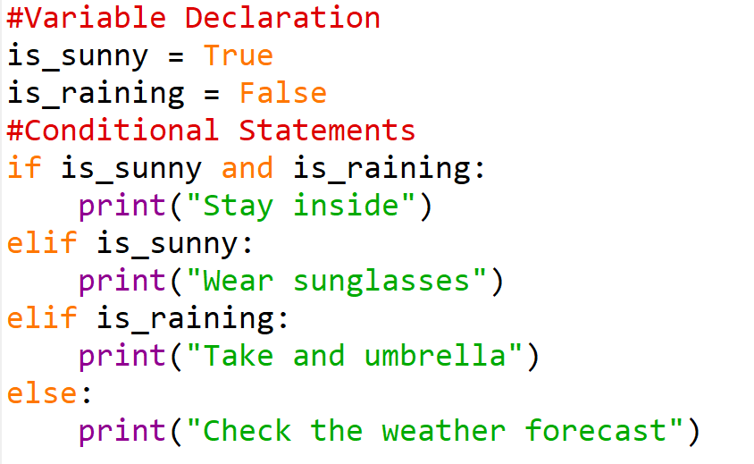
Solution for last week’s task

Slide 2
Fundamentals Part 3

Slide 3
Content
Loops
Iteration
While Loops
For Loops
Lists continued

Slide 4
Introduction to Loops
Loops are structures that allow you to repeat a block of code multiple times, also known as iteration
Very powerful as they enable automation and processing of large amounts of data with minimal code
Here are some examples of their applications in research
Data Processing and Analysis
Simulation and Modelling
Optimization and Parameter Tuning
Automation and Reproducibility
Customized Analyses and Experimentation

Slide 5
Understanding Iteration
Iteration is the process of repeating a set of instructions a certain number of times
Allows us to automate repetitive tasks in programming
Examples of iteration in everyday life
Washing the dishes; picking up a dish, putting water on dish, scrubbing dish, putting water on dish, put on drying rack -> Repeat
Laundry; Picking of clothes, loading into machine -> Repeat

Slide 6
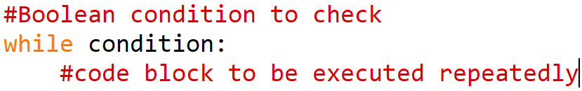
While loops
Purpose = Used for iteration a non-fixed amount of times
A while loop is a control flow statement that allows code to be executed repeatedly based on a given Boolean condition
Syntax:
If condition not configured properly, will loop infinitely
Also, why while loop is sometimes called an infinite loop

Slide 7

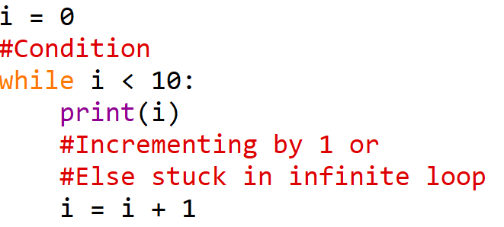



While Loops Example 0
Infinite loop, if not increasing each loop round

Slide 8
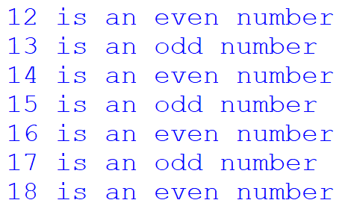
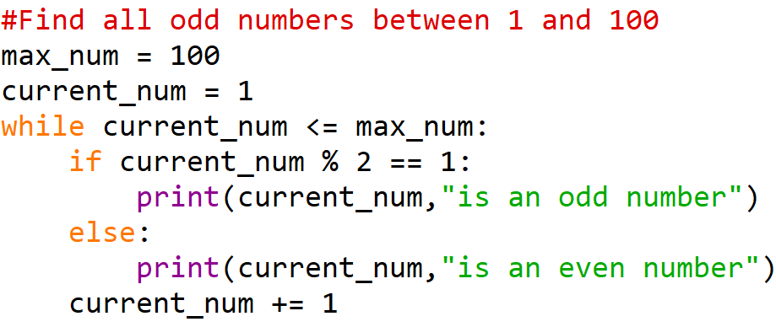
While Loops Example 1
For this we are wanting to find all odd numbers between 1 and 100

Slide 9
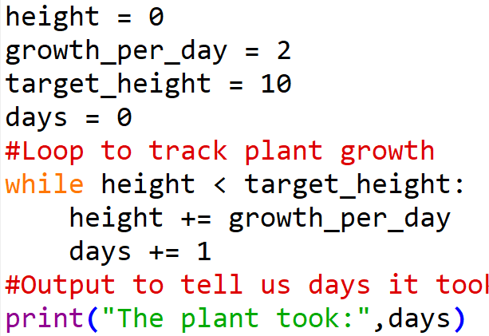

While Loops Example 2
For this we are wanting to track how many days it took for plant to reach target height

Slide 10
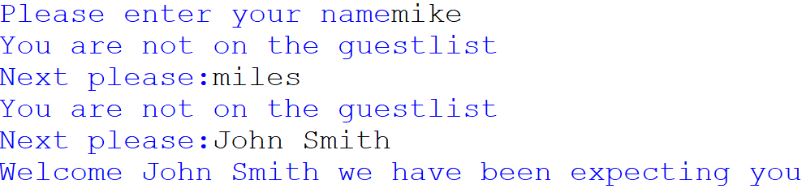
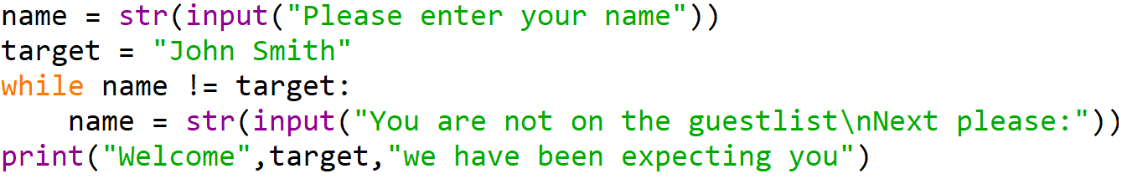
While Loops Example 3
You are going to an event which is invite only, to get in you give your name to be checked in

Slide 11
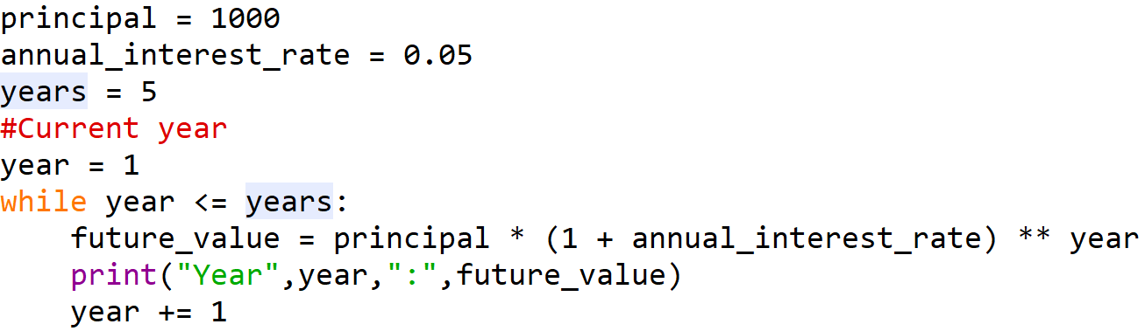
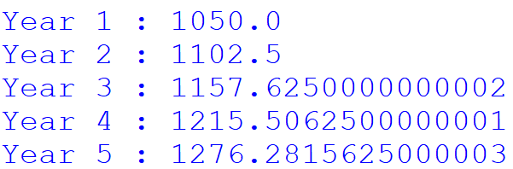
While Loops Example – Real World

Slide 12
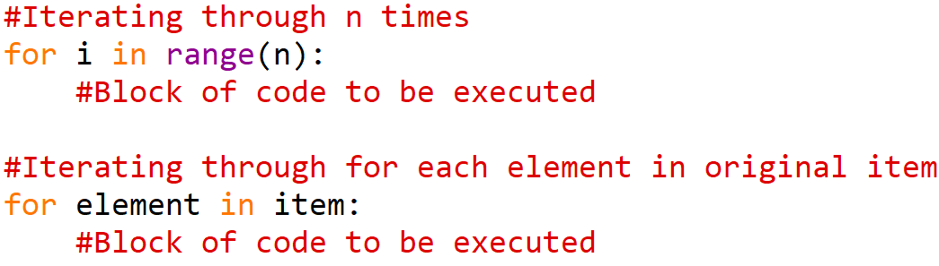
For loops
Purpose = Used for iteration a fixed number of times
Allows you to perform a task repeatedly over a sequence of items
Syntax:

Slide 13
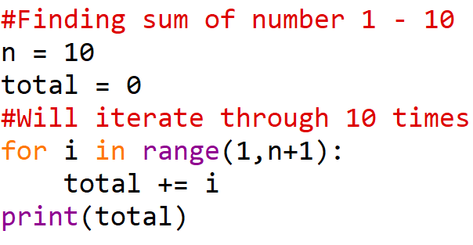

For – With range
Allows you to iteration a predefined amount, whether you give, or it is input based
Useful if you need the index of an item to finish a task
Range function goes from 0 to Number – 1 if not specified due to Zero indexing

Slide 14

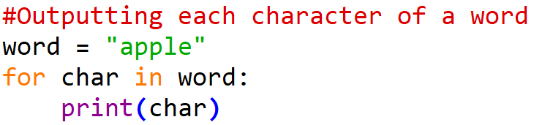
For - In
Purpose = Used to iterate over a collection of items, and perform a task for each item
Has simplicity and readability compared to for with range

Slide 15

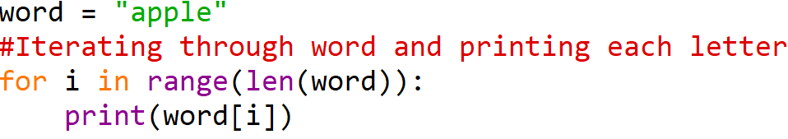
For Loop Example 1 – Over a String

Slide 16

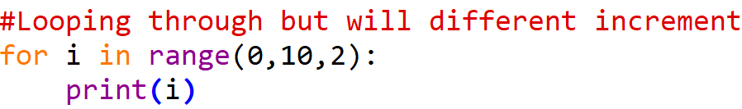
For Loop Example 2
The range function is extremely versatile
Starts from 0 by default and will increment by 1 by default
Although by example that can be changed
Maximum must always be stated

Slide 17
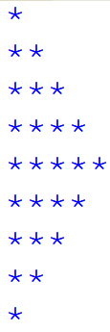
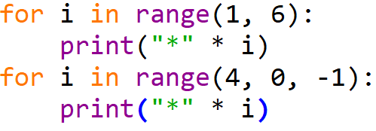
For Loop Example 3
Can also be used to create shapes

Slide 18
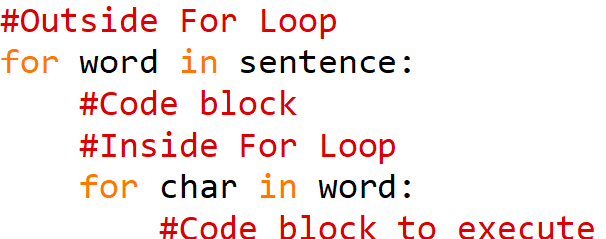
Nested For Loops
Just a for loop placed inside another for loop where you’d expect the code block
Works similarly to a Nest Logical statement
Syntax:

Slide 19
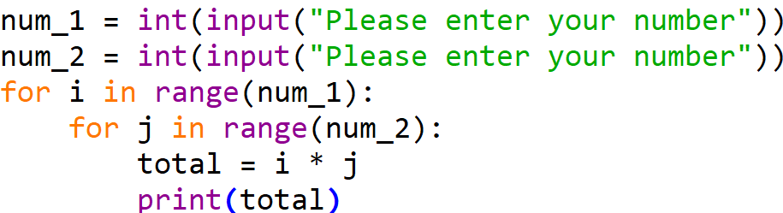
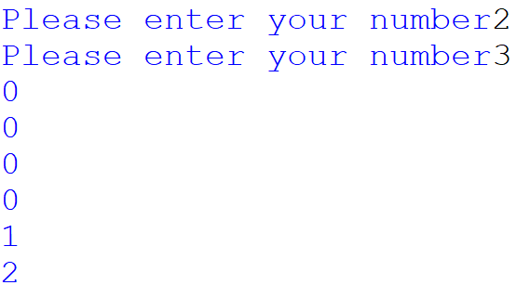
Nested For Loops Example 1

Slide 20

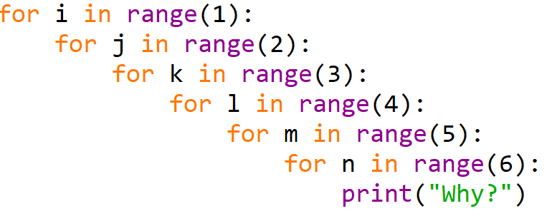
Nested For Loop Example 2
Can have as many nested inside as you want

Slide 21
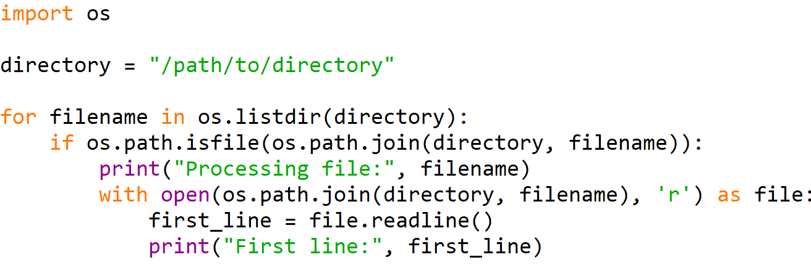
For Loop Example – Real World
Allows us to get a list of all files in a directory on a computer

Slide 22
Deciding which loop type to use
A for loop is a promise
Meaning that even if the condition you want to be met is met, you should not break the loop
Increases time wasted
Useful if you know the number of times you want the loop to be executed
A while loop is a statement
Meaning at any one time as soon as a condition is met the loop can be broken
Decreases time wasted
Useful if you don’t know the number of times you want the loop to be executed

Slide 23
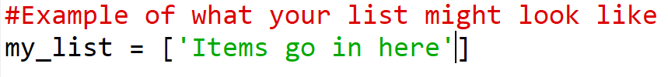
Lists continued
Def = Ordered collection of items or elements, can contain multiple data types
Lists are zero indexed meaning first element is at position zero and second element is at position one and so on and so forth
Lists have a defined order and can only change using list methods
Dynamic size not fixed unless specified
Syntax:

Slide 24
Lists continued – Bookshelf analogy
A list can be imagined as a bookshelf
Where multiple book (elements) in a specific order
Each book has a unique position just like element in list having an index
New books are added (append method)
Remove books (pop method)
Rearrange the order of the books (insert method)

Slide 25
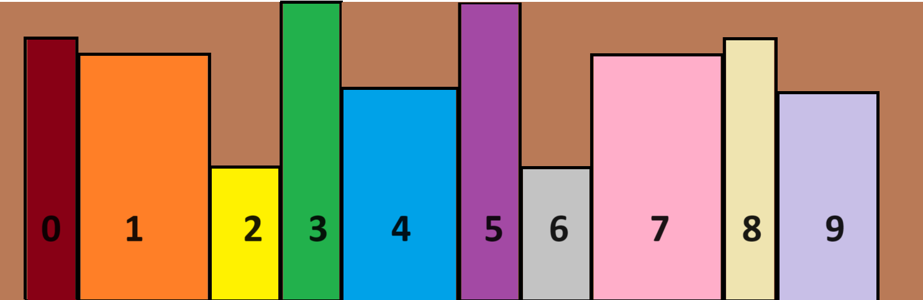
Lists continued – Bookshelf analogy

Slide 26
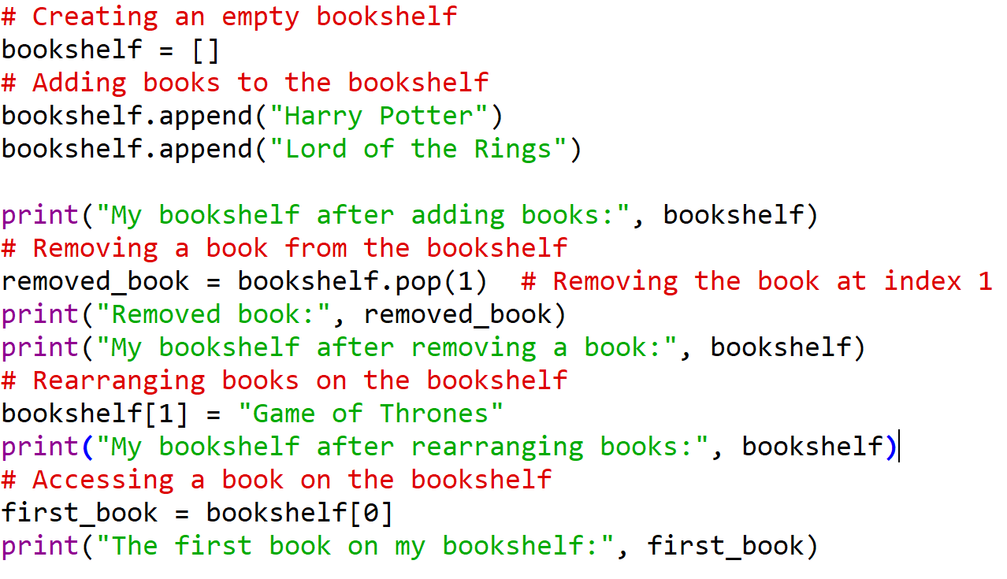
Lists continued Example – Bookshelf analogy

Slide 27
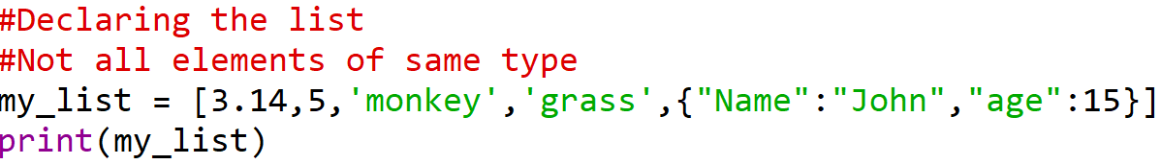
Lists Example 1

Slide 28
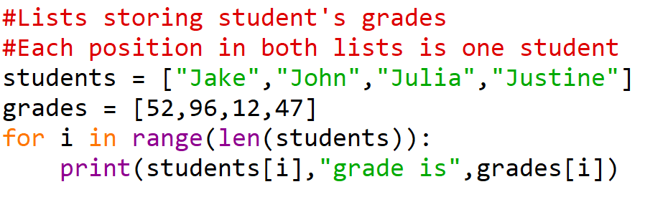
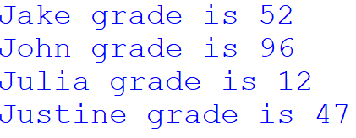
Lists Example 2

Slide 29
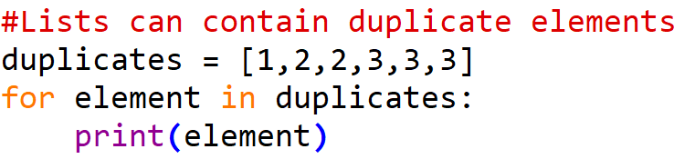

Lists Example 3

Slide 30
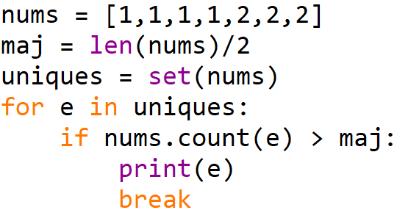

Lists Example – Real World

